Slide 1
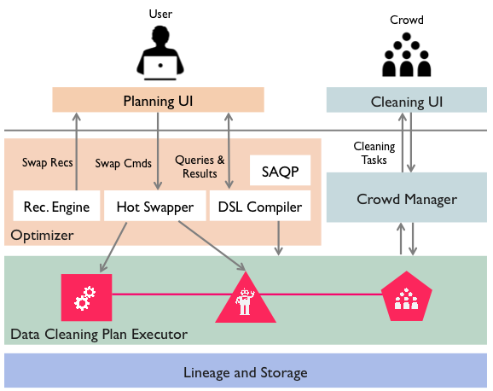
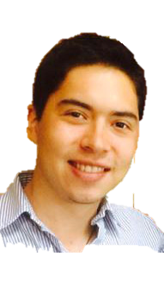
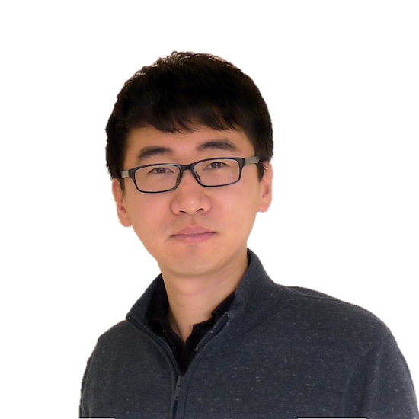
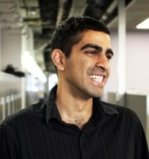
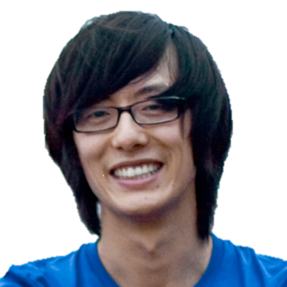
We are designing a scalable data cleaning system combining declarative optimization and crowds
Juan Jaramillo
Cal
Sanjay Krishnan
Cal
Daniel Haas
Cal
Jiannan Wang
Cal
Eugene Wu
Columbia

